Slide 1
Statistical Learning Methods

Slide 2
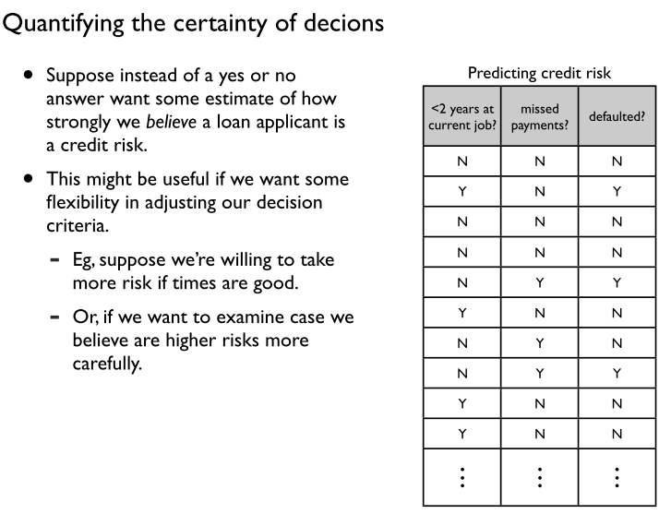

Slide 3
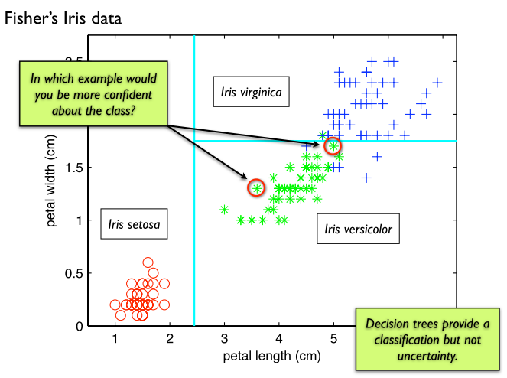

Slide 4
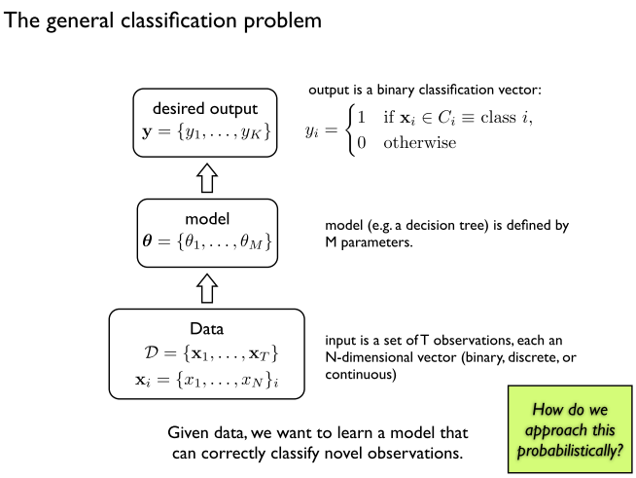

Slide 5
Statistical Approaches
Statistical Learning (20.1)
Naïve Bayes (20.2)
Instance-based Learning (20.4)

Slide 6
Example: Candy Bags
Candy comes in two flavors: cherry (☺) and lime (☹)
Candy is wrapped, can’t tell which flavor until opened
There are 5 kinds of bags of candy:
H₁= all cherry
H₂= 75% cherry, 25% lime
H₃= 50% cherry, 50% lime
H₄= 25% cherry, 75% lime
H₅= 100% lime
Given a new bag of candy, predict H
Observations: D₁, D₂ , D₃, …

Slide 7
Bayesian Learning
Calculate the probability of each hypothesis, given the data, and make prediction weighted by this probability (i.e. use all the hypothesis, not just the single best)
Now, if we want to predict some unknown quantity X

Slide 8
Bayesian Learning cont.
Calculating P(h|d)
Assume the observations are i.i.d.—independent and identically distributed
如何做到這一點？
likelihood
prior

Slide 9
Example:
Hypothesis Prior over h₁, …, h₅ is {0.1,0.2,0.4,0.2,0.1}
Data:
Q1: After seeing d₁, what is P(h_{i}|d₁)?
Q2: After seeing d₁, what is P(d₂= |d₁)?

Slide 10
Q1: After seeing d₁, what is P(h_{i}|d₁)?
Hypothesis Prior over h₁, …, h₅ is {0.1,0.2,0.4,0.2,0.1}
H₁= all cherry
H₂= 75% cherry, 25% lime
H₃= 50% cherry, 50% lime
H₄= 25% cherry, 75% lime
H₅= 100% lime

Slide 11
Q2: After seeing d₁, what is P(d₂= |d₁)?

Slide 12
Making Statistical Inferences
Bayesian –
predictions made using all hypothesis, weighted by their probabilities
MAP – maximum a posteriori
uses the single most probable hypothesis to make prediction
often much easier than Bayesian; as we get more and more data, closer to Bayesian optimal
ML – maximum likelihood
assume uniform prior over H
when

Slide 13
Naïve Bayes
aka Idiot Bayes
particularly simple BN
makes overly strong independence assumptions
but works surprisingly well in practice…

Slide 14
Bayesian Diagnosis
suppose we want to make a diagnosis D and there are n possible mutually exclusive diagnosis d₁, …, d_{n}
suppose there are m boolean symptoms, E₁, …, E_{m}
how do we make diagnosis?
we need:

Slide 15
Naïve Bayes Assumption
Assume each piece of evidence (symptom) is independent give the diagnosis
then
what is the structure of the corresponding BN?

Slide 16
Naïve Bayes Example
possible diagnosis: Allergy, Cold and OK
possible symptoms: Sneeze, Cough and Fever
 | Well | Cold | Allergy
P(d) | 0.9 | 0.05 | 0.05
P(sneeze|d) | 0.1 | 0.9 | 0.9
P(cough|d) | 0.1 | 0.8 | 0.7
P(fever|d) | 0.01 | 0.7 | 0.4
My symptoms are: sneeze & cough, what is the diagnosis?

Slide 17
 | Well | Cold | Allergy
P(d) | 0.9 | 0.05 | 0.05
P(sneeze|d) | 0.1 | 0.9 | 0.9
P(cough|d) | 0.1 | 0.8 | 0.7
P(fever|d) | 0.01 | 0.7 | 0.4

Slide 18
Learning the Probabilities
aka parameter estimation
we need
P(d_{i}) – prior
P(e_{k}|d_{i}) – conditional probability
use training data to estimate

Slide 19
Maximum Likelihood Estimate (MLE)
use frequencies in training set to estimate:
where n_{x} is shorthand for the counts of events in
training set

Slide 20
Example:
what is:
P(Allergy)?
P(Sneeze| Allergy)?
P(Cough| Allergy)?
D | Sneeze | Cough | Fever
Allergy | yes | no | no
Well | yes | no | no
Allergy | yes | no | yes
Allergy | yes | no | no
Cold | yes | yes | yes
Allergy | yes | no | no
Well | no | no | no
Well | no | no | no
Allergy | no | no | no
Allergy | yes | no | no

Slide 21
Laplace Estimate (smoothing)
use smoothing to eliminate zeros:
many other smoothing
schemes…
where n is number of possible values for d
and e is assumed to have 2 possible values

Slide 22
Comments
Generally works well despite blanket assumption of independence
Experiments show competitive with decision trees on some well known test sets (UCI)
handles noisy data

Slide 23
Learning more complex Bayesian networks
Two subproblems:
learning structure: combinatorial search over space of networks
learning parameters values: easy if all of the variables are observed in the training set; harder if there are ‘hidden variables’

Slide 24
Instance/Memory-based Learning
Non-parameteric
hypothesis complexity grows with the data
Memory-based learning
Construct hypotheses directly from the training data itself

Slide 25
Nearest Neighbor Methods
To classify a new input vector x, examine the k-closest training data points to x and assign the object to the most frequently occurring class
k=1
k=6
x

Slide 26
Issues
Distance measure
Most common: Euclidean
Better distance measures: normalize each variable by standard deviation
For discrete data, can use hamming distance (the number of unequal corresponding attributes between two discrete-valued vector)
Choosing k
Increasing k reduces variance, increases bias
For high-dimensional space, problem that the nearest neighbor may not be very close at all! (See the example in textbook)
Memory-based technique. Must make a pass through the data for each classification. This can be prohibitive for large data sets.
Indexing the data can help; for example KD trees

Slide 27
Dimension！Dimension！!
Consider KNN on a data set of N points uniformly distributed throughout the interior of an n-dimensional unit hypercube.
k-neighborhood of a point: the smallest hypercube that contains the k-nearest neighbors.
Let l be the average side length of a neighborhood. The volume of the k-neighborhood is l ^{n} and the volume of the full cube is 1.
l ^{n} = k/N
To be concrete, let k = 10 and N =1,000,000.
n = 2: l = 0.003 n = 3: l = 0.02
But n = 17: l = 0.5
n = 200: l = 0.94!!
curse of dimensionality

Slide 28
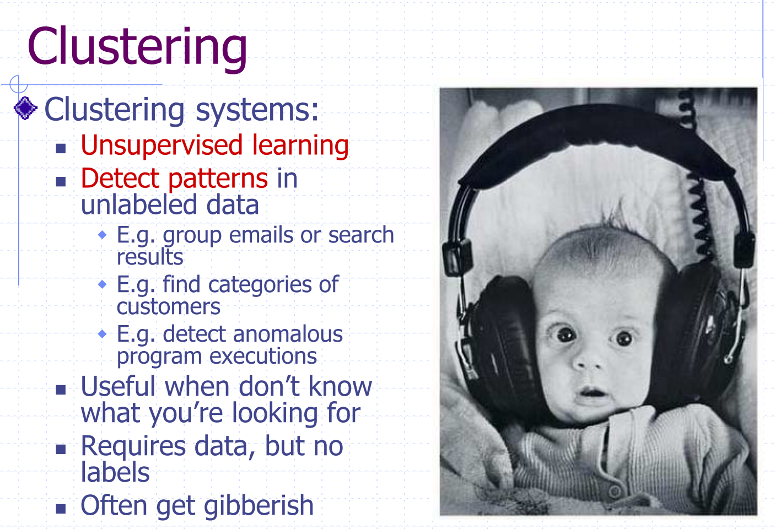
快速而不清楚的言语

Slide 29
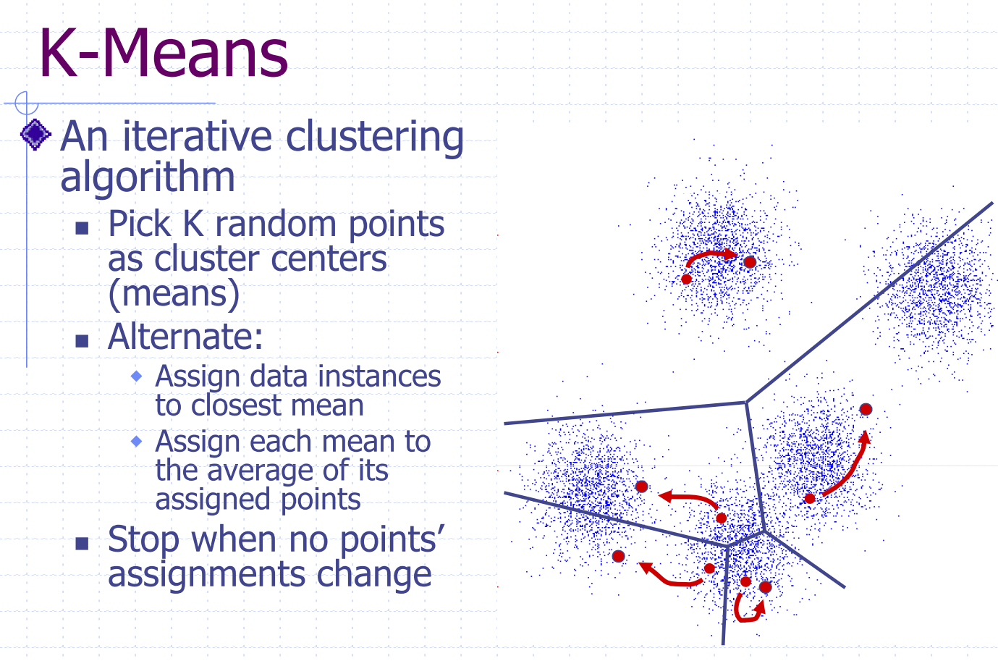

Slide 30
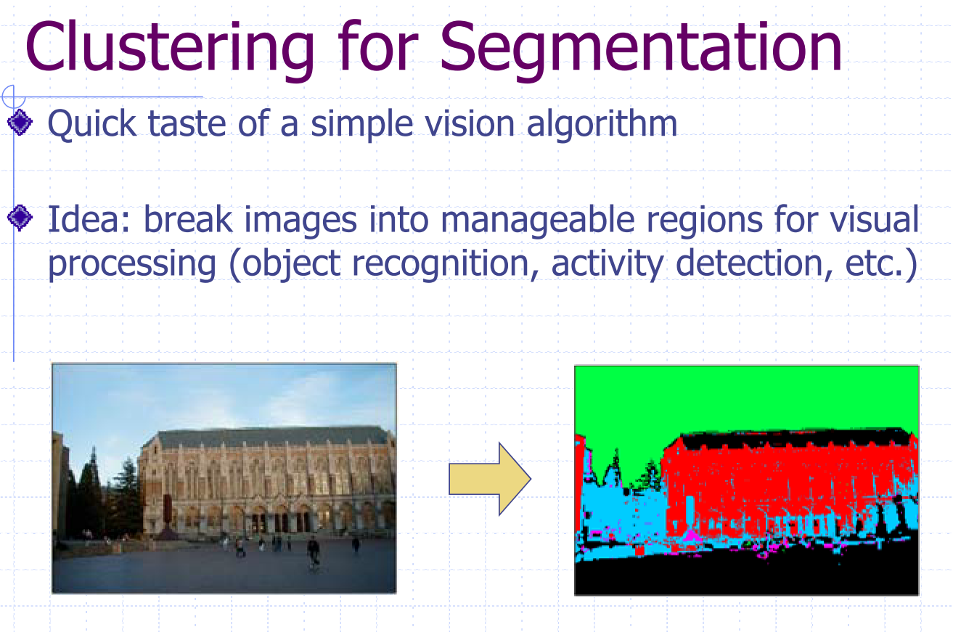

Slide 31
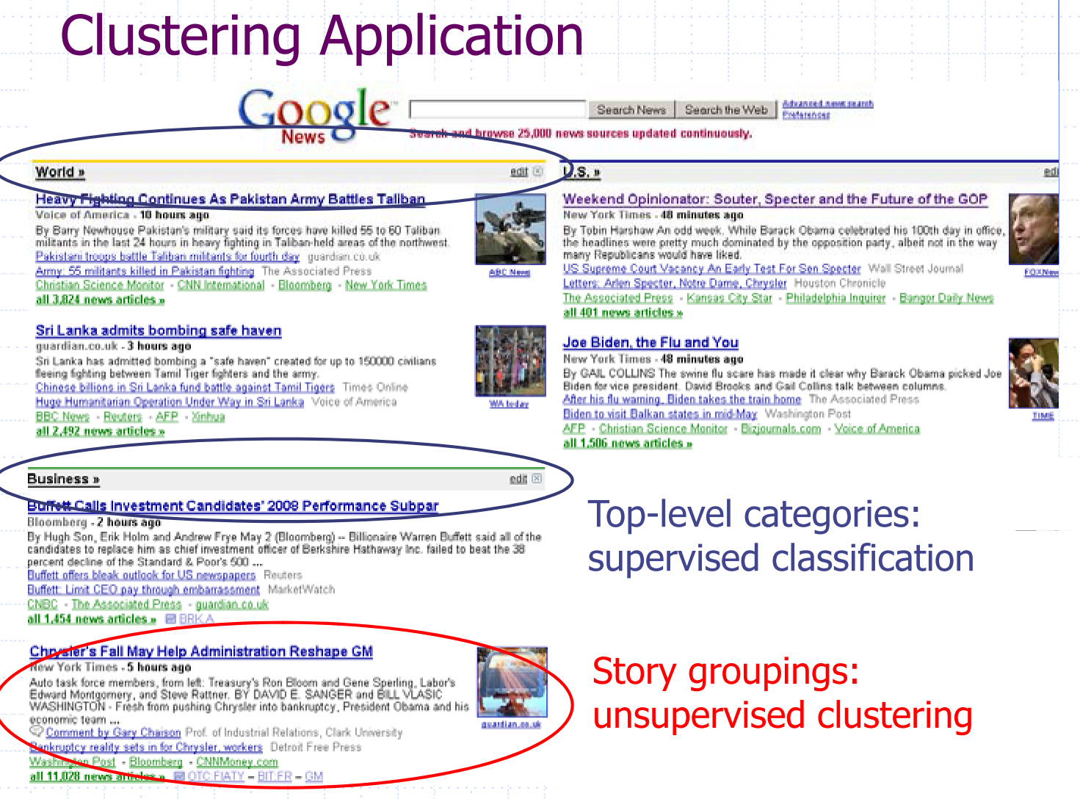

Slide 32
